Slide 1
#2025 Sustainability Goals: Leading the Blueprint Blueprint Thinking Toolkit for External Engagement
Executive Sponsors: Neil Carr, Mary Draves, Kevin Kolevar
Implementation Leaders: Jihane Ball, Carrie Houtman
Project Manager: Justine Nelson
Updated January 2020
Toolkit and training materials developed in collaboration with the Keystone Policy Center

Slide 2
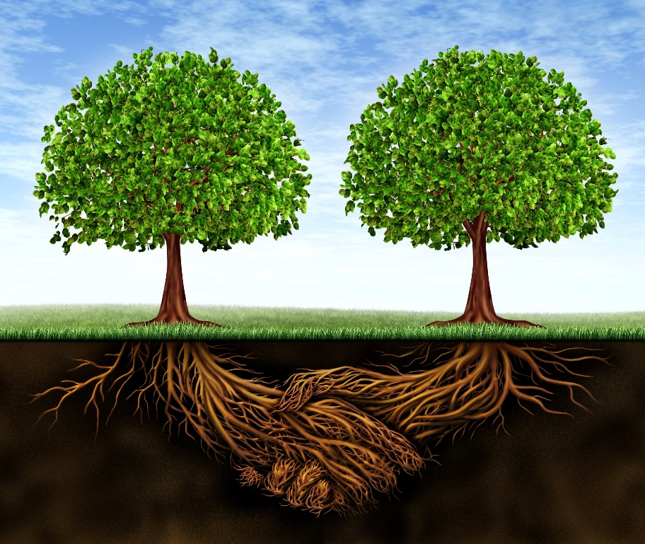
2025 Goal: Leading the Blueprint
Can you imagine a future where businesses, governments, and society work together to advance solutions that preserve our planet and ensure a sustainable future for all?
Dow can.
Why should we engage or collaborate externally?
Society demands it. Many of the complex challenges we face today, like decreasing plastics in our ocean, combatting climate change, and enabling sustainable, reliable water supplies cannot be done by Dow alone.
Many of the best solutions and the necessary buy-in for these solutions require new kinds of collaborations for Dow that we may not have considered before.
How should we engage or collaborate externally?
The Leading the Blueprint goal is about equipping Dow employees to confidently navigate the world of external engagement and collaborations in an organized, value-add way using the Blueprint Thinking Toolkit for External Engagement and creating blueprints.
What are the blueprint thinking toolkit and blueprints?
The blueprint thinking toolkit provides a framework to navigate the internal and external planning, collaborations, and communications required in considering external engagement for a complex issue or project.
Some of these materials we share externally as “blueprints”.
Leading the Blueprint Goal:
Developing societal blueprints on how we can collaborate with others to integrate
public policy solutions
science and technology
value chain innovation
to facilitate the transition to a sustainable planet and society.
Collaborate
Communicate
Blueprint Thinking
→
←
=
The objective of this training is to introduce and walk through the blueprint thinking toolkit.

Slide 3
Introduction and Note on Usage of the Blueprint Thinking Toolkit
The Blueprint thinking toolkit is designed to enable businesses or groups within Dow to confidently engage with external parties in ways that are mutually beneficial.
The toolkit is an excel workbook with an accompanying how-to powerpoint.
The objective of this toolkit is to provide a framework to follow and thought-provoking questions to help you and your team think outside the box when it comes to external engagements.
You do not need to complete each of the toolkit sections in detail or adhere to its excel spreadsheet format. The recommended stages make sense for many projects, but EVERY project will be different. Pick and choose which tools work best for you as you navigate your project.
The path to effective external engagement and shared value is both winding and rewarding!
Collaborate
Communicate
Blueprint Thinking
→
←
=

Slide 4
Blueprint stages in the Blueprint Thinking Toolkit
There are three stages in the blueprint thinking process.
The Blueprint Thinking Toolkit provides tools (in an excel workbook) for each stage.
PROJECT
ALIGNMENT
Design and solidify a project strategy and assemble internal resources (people and existing materials)
STAKEHOLDER MAPPING
Identify and prioritize external stakeholders for mutually beneficial engagement
EXTERNAL ENGAGEMENT
Plan for working relationships and external communications with select organizations and audiences
What is the value to Dow in doing this work?
Who is your internal team? Are you missing anyone?
What existing materials or proofpoints do you have that highlight Dow as a credible, collaborative partner?
What is the value in engaging externally?
Who are your current external partners/collaborators? Are you missing any perspectives or key sectors?
What criteria in external collaborators is most important to you to achieve your goals with this project and which stakeholders fit that criteria?
What is the best mode of engagement with your preferred stakeholders?
What do you and your stakeholders value or need from the collaboration?
Have you considered official MOUs or trigger points to exit the engagement?
How do you most effectively communicate with your target stakeholders?
How do you create and leverage materials to communicate and drive action more broadly, like the creation of “blueprints”?
Do you have specific calls for action?
Have you considered venues or effective spokespeople to launch materials?

Slide 5
Blueprint stages and toolkit spreadsheet sections
All excel spreadsheet sections in the toolkit are color coordinated with their corresponding stages (below).
The following slides will provide a snapshot of each toolkit spreadsheet section plus some additional case study learnings from previous blueprint teams.
Blueprint Stage | Toolkit Spreadsheet Section | Purpose
PROJECT ALIGNMENT | Internal alignment | Clarify a project strategy, need for engagement. Build your team.
 | Materials and case studies | Capture lessons learned and catalogue relevant information
STAKEHOLDER MAPPING | Stakeholder landscape | Define your project and build a stakeholder list
 | Stakeholder assessment | Prioritize sectors and stakeholders for engagement
 | Stakeholder gap analysis | Conduct a gap analysis of sectors and stakeholders
 | Stakeholder map | Strategize engagement with specific stakeholders
EXTERNAL ENGAGEMENT | Engagement plan | Clarify roles and responsibilities with external stakeholders
 | Inter-org communications | Strategize communications with external organizations
 | External communications | Strategize communications with broader external audiences

Slide 6
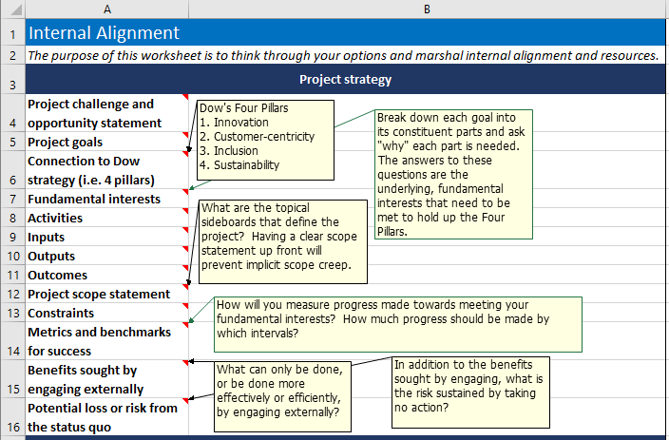
Project Alignment - Internal Alignment – 1. Project Strategy
Internal alignment section
Project strategy | Take time here to get clear on what you are trying to do with the engagement initiative, starting with the challenge you are trying to overcome or the opportunity you are pursuing. Clarifying the benefits to be gained from engaging externally will give you directional guidance throughout your project and help you promote and defend it internally. A clear scope, constraints, and metrics for success will supply the necessary sideboards to keep the project focused. Often the risks of engaging are more evident than the risks of doing nothing. Take a moment to consider what would happen if you did nothing.
What is the value of your project and how does it align with Dow’s strategy?
PROJECT
ALIGNMENT
Design and solidify a project strategy and assemble internal resources (people and existing materials)
STAKEHOLDER
MAPPING
Identify and prioritize external stakeholders for mutually beneficial engagement
EXTERNAL
ENGAGEMENT
Plan for working relationships and external communications with select organizations and audiences

Slide 7
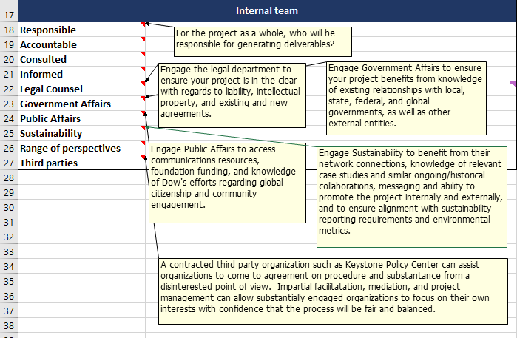
Project Alignment - Internal Alignment – 2. Internal Team
Internal alignment section
Internal Team | Building an internal team intentionally, with clear roles from the beginning will promote efficiency and prevent misunderstandings later. Dow has a wealth of resources internally (such as government affairs, public affairs, and sustainability) to ensure you get started on the right foot. Consider bringing in a third party to facilitate information gathering, collaborative process design, or be on hand to assist with difficult issues that arise.
Do you have the right internal team in place to be successful or could you benefit from additional resources??
PROJECT
ALIGNMENT
Design and solidify a project strategy and assemble internal resources (people and existing materials)
STAKEHOLDER
MAPPING
Identify and prioritize external stakeholders for mutually beneficial engagement
EXTERNAL
ENGAGEMENT
Plan for working relationships and external communications with select organizations and audiences

Slide 8
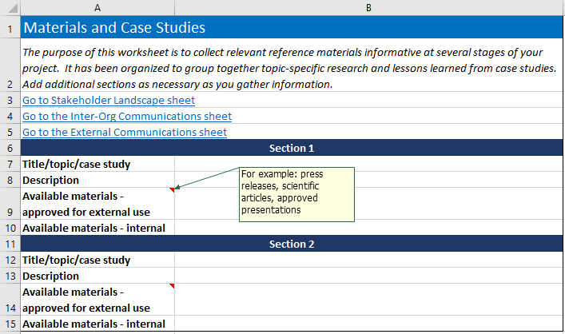
Project Alignment – Materials and Case Studies
Materials and case studies section
Materials and case studies | This space is a catch-all catalogue for applicable links, case studies, and other information that is applicable to your project. It is organized to keep distinct those materials that are approved for external sharing and those that need to remain internal. Links have been provided to sections further on that will reference back to the information compiled here. This page will serve as your source for lessons learned, your reference for accessing existing networks and relationships, and as a source of engaging stories for communications.
What existing materials or proofpoints do you have that highlight Dow as a credible, collaborative partner?
PROJECT
ALIGNMENT
Design and solidify a project strategy and assemble internal resources (people and existing materials)
STAKEHOLDER
MAPPING
Identify and prioritize external stakeholders for mutually beneficial engagement
EXTERNAL
ENGAGEMENT
Plan for working relationships and external communications with select organizations and audiences

Slide 9
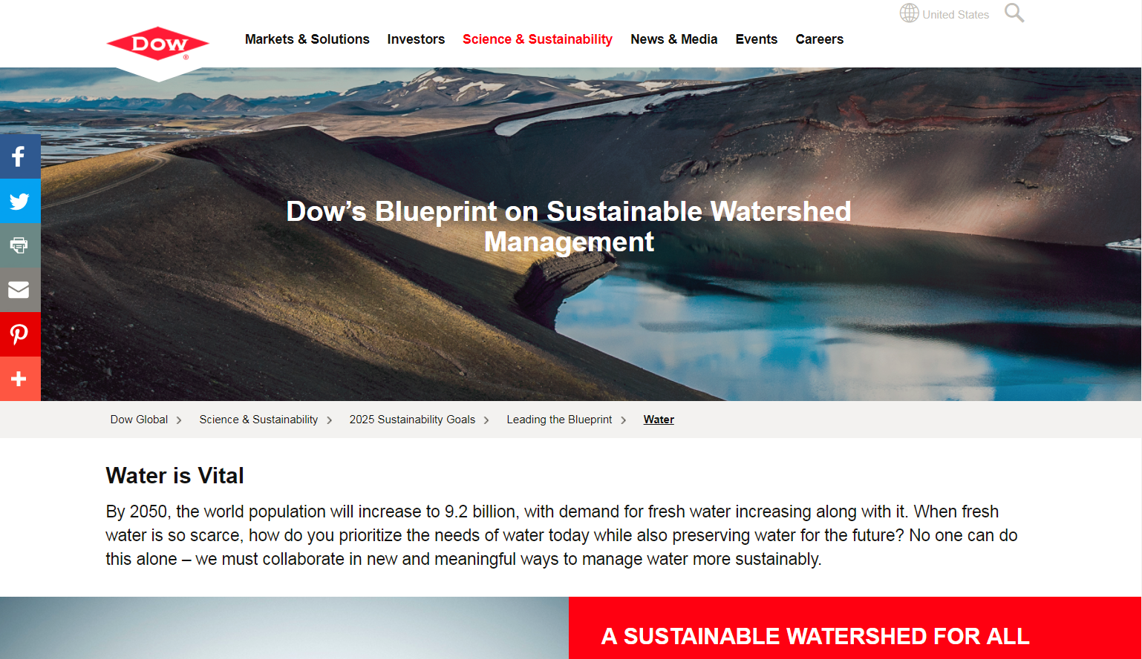
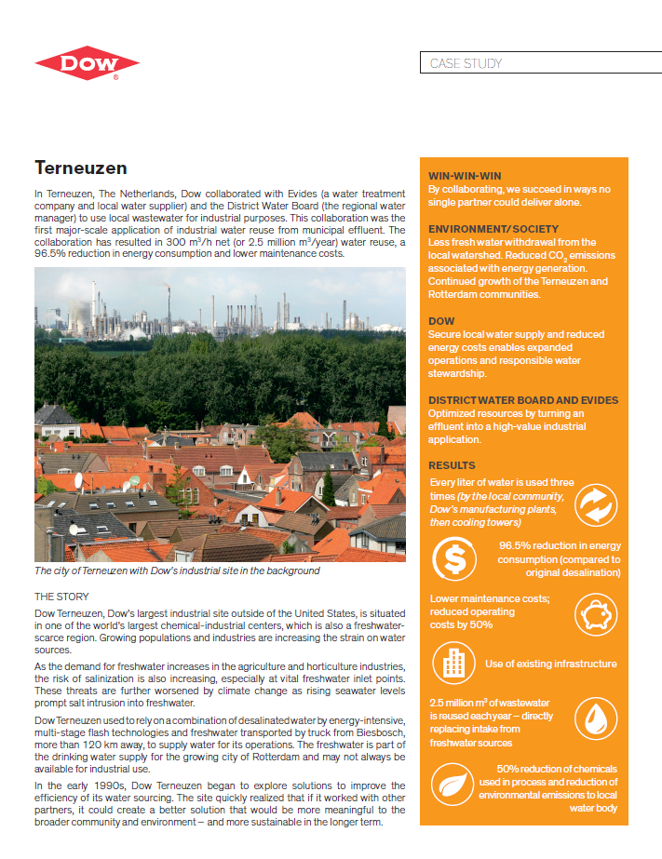
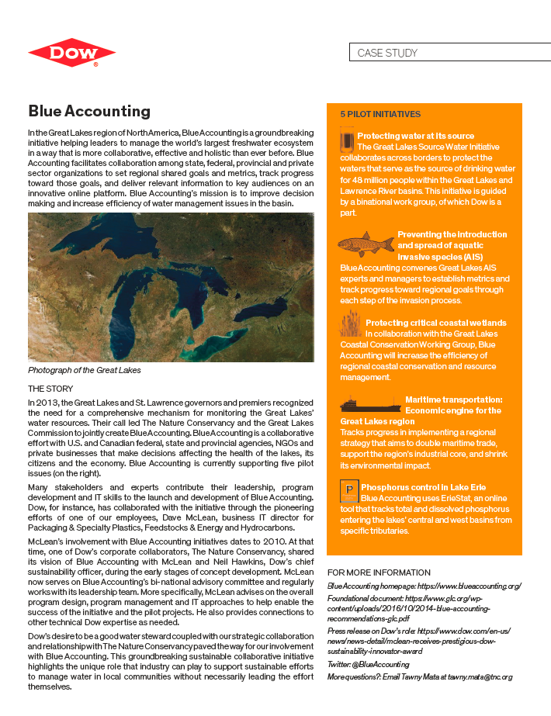
DRAFT: Watershed Management Blueprint Lessons
PROJECT
ALIGNMENT
Design and solidify a project strategy and assemble internal resources (people and existing materials)
STAKEHOLDER
MAPPING
Identify and prioritize external stakeholders for mutually beneficial engagement
EXTERNAL
ENGAGEMENT
Plan for working relationships and external communications with select organizations and audiences
Identified 3 priority areas in water for Dow but no internal “owners” or “drivers” of Dow’s water strategy so we focused on creating a catalogue/one-stop-shop of water-related case studies to share externally.
Reuse water at our sites
Value Water (and nature!) in our watersheds
Clean up the watersheds where we live and work
Realizing that there wasn’t an internal team to drive Dow’s water strategy at this time, we should have considered pausing work on this blueprint until a time when there would be more internal momentum to drive it.
With water, many collaborations are local and site-specific and our water strategy continues to be more locally driven which is challenging in applying broader stakeholder mapping techniques.
Identified need for larger, global collaborations we could partner with to leverage their tools, processes, and connections on water.
Initiated collaboration with CEO Water Mandate Action Platform but the relationship was not as valuable as we initially hoped.
Why not? We were not clear in our expectations of the relationship and while they helped us arrange speaking slots, they were not a partner in developing tools or advancing Dow’s strategy nor did we provide consistent Dow engagement to drive the relationship.
Without owners or drivers internally, we created the water blueprint page to share our case studies and priorities on water (specifically written with more detailed “how-to” steps that don’t require as much in-detail explanation) but not push for broader external engagement with specific calls to action.
Soft launched at World Water Day in Brazil in spring 2018 (Dow’s speaking slot arranged by CEO Water Mandate)
Full launch at UN High Level Political Forum on Water summer 2018 (Dow’s speaking slot arranged by CEO Water Mandate)
Leveraged materials from World Water Day Dow activities to update the blueprint in 2019 without requiring additional resources.
www.dow.com/waterblueprint
Project Alignment Lesson: Make sure there is internal buy-in with clear owners and drivers for your project to ensure resources and strategic priorities are aligned.

Slide 10
Note on Third parties
Keystone and other partners or third parties can be helpful in implementing engagement in the following ways:
Gathering and summarizing stakeholder feedback on a specific issue to understand perspectives, identify needs, and overall willingness to engage:
For example, Dow has mentioned wanting to convene stakeholders in the Great Lakes region around increasing recycling rates. Keystone could work with Dow to identify key players, conduct an initial consultation about how and where stakeholder coordination would be helpful, identify barriers and make recommendations for next steps
Consulting with Dow staff on overall strategy for engagement on difficult issues where more than one partner will be needed or where there is some level of tension with potential partners including internal and external engagement strategies
Helping design and define and convene multi-stakeholder processes to reach effective outcomes
Reviewing overall engagements in an area and facilitating discussions about high value engagements and priorities vs participation in others.
Providing skills training and workshops on negotiation and engagement
Who to contact from Keystone Policy Center?
Sarah Alexander: salexander@keystone.org
General: info@keystone.org

Slide 11
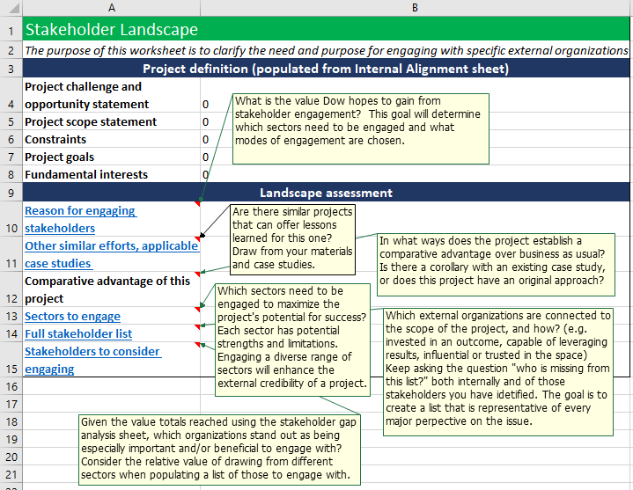
Stakeholder mapping – Stakeholder Landscape
Stakeholder landscape section
Project definition | These fields auto-populate from your work in the Internal Alignment section, ensuring that your project’s core goals, scope, and constraints are quickly at hand.
Landscape assessment | The landscape assessment encourages you to double check your reasoning and think as broadly as possible about the value of engaging different sectors and multiple stakeholders. This sheet links to a number of in-toolkit resources and positions them next to your own reasoning and research to paint a picture of the stakeholder landscape around your project or issue area.
Are you thinking broadly enough about what your value and needs are in external engagement?
PROJECT
ALIGNMENT
Design and solidify a project strategy and assemble internal resources (people and existing materials)
STAKEHOLDER
MAPPING
Identify and prioritize external stakeholders for mutually beneficial engagement
EXTERNAL
ENGAGEMENT
Plan for working relationships and external communications with select organizations and audiences

Slide 12
Stakeholder mapping – Stakeholder assessment
Have you defined the criteria you need in an external collaborator to achieve your goals and ranked current or potential collaborators?
Stakeholder assessment section
Assessment questions | Populate your list of stakeholder organizations that you currently work with, that others in the organization may work with, and brainstorm others that may be of interest to engage. Use the relative sector strengths to expand your thinking and the questions as a guide for your research into their motivations and perspective.
Stakeholder perspectives by sector | Develop a ranking system to determine how much good can potentially be gained for the objectives of YOUR project by engaging with each stakeholder.
PROJECT
ALIGNMENT
Design and solidify a project strategy and assemble internal resources (people and existing materials)
STAKEHOLDER
MAPPING
Identify and prioritize external stakeholders for mutually beneficial engagement
EXTERNAL
ENGAGEMENT
Plan for working relationships and external communications with select organizations and audiences

Slide 13
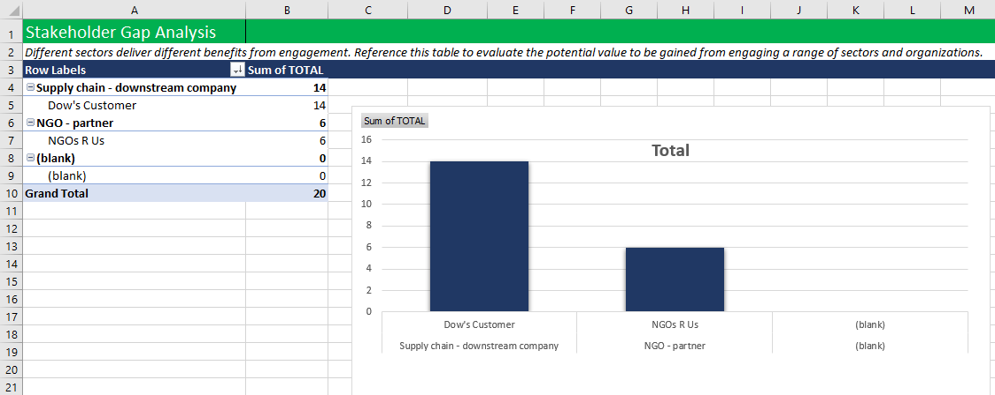
Stakeholder mapping – Stakeholder Gap Analysis
Do you want to use additional tools to visualize your stakeholders and analyze who you might be missing?
Stakeholder gap analysis section
Sector diversity | The scoring from your stakeholder assessment will populate this pivot table, which can give you a glimpse into the relative value of engaging entities from different sector, providing one source of data that can apply to your decision to engage with a given organization.
PROJECT
ALIGNMENT
Design and solidify a project strategy and assemble internal resources (people and existing materials)
STAKEHOLDER
MAPPING
Identify and prioritize external stakeholders for mutually beneficial engagement
EXTERNAL
ENGAGEMENT
Plan for working relationships and external communications with select organizations and audiences

Slide 14
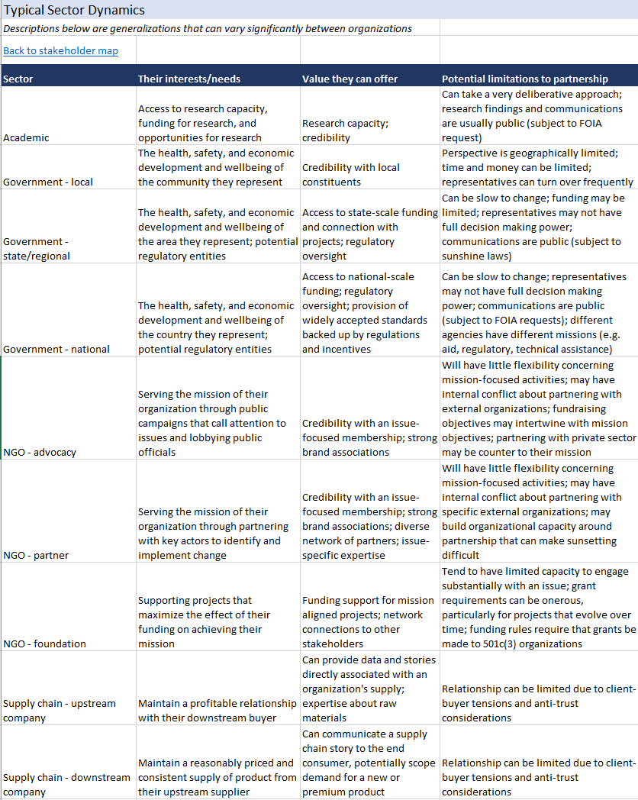
Sector Strengths and Dynamics
Consider the pros and cons of certain sectors and players.
You don’t have to partner with everyone, but you should know who has the key viewpoints surrounding your goal.
Is there a reason why you aren’t including a certain sector or player, or have they been overlooked?
Have you included people with opposing viewpoints to Dow?

Slide 15
Valuing Nature Blueprint Learnings
Objective and background: Dow has a unique 2025 sustainability goal to get $1 billion of business value through nature and a corresponding multi-year strategic relationship with The Nature Conservancy to help achieve this. The team has recently been pulled to give external workshops with customers and other stakeholders as well as speak more frequently about the goal.
What do these stakeholders really want to know about Dow and the Nature goal and what possible collaborative opportunities are there? How do we organize our proof points and messages and develop materials that can be leveraged to additional external stakeholders?
Team: Sustainability Academy Cohort 5 team (2H19) with Valuing Nature 2025 goal team
Blueprint Learnings:
PROJECT ALIGNMENT
Design and solidify a project strategy and assemble internal resources (people and existing materials)
STAKEHOLDER MAPPING
Identify and prioritize external stakeholders for mutually beneficial engagement
EXTERNAL ENGAGEMENT
Plan for working relationships and external communications with select organizations and audiences
With new Dow Valuing Nature leadership and goal team, offers the opportunity to think through intended external engagement strategy for the goal.
The team identified additional internal resources like LCA experts, Supply Chain, R&D, and Ventures & Business Development and outlined opportunities for value-add engagement with the nature goal
The team catalogued many of the existing case studies into one excel sheet in an easy-to-use filtering format to help organize the main messages and existing external proofpoints from each case study.
The team worked extensively on developing the Blueprint Thinking Toolkit section on Stakeholder Assessment and found this a useful exercise to identify viewpoints and possible opportunities for the Valuing Nature team to develop new collaboration opportunities.
The team engaged in the planning processes for workshops that were planned for the Army Corps of Engineering and 3M, both valuable new external collaborators.
They developed blueprint materials with Studio 2020 taking into account the priorities of these stakeholders but in a way that can be leveraged across multiple stakeholders.
Stakeholder Mapping Lesson: Stakeholder mapping is an important exercise to make sure you are including out-of-the-box perspectives and possible collaborations. It is an iterative process that requires you to constantly ask, who am I missing, and can lead to valuable new collaborations and solutions.
15
The following slides show examples of the Valuing Nature Stakeholder Assessment worksheet and blueprint materials.

Slide 16
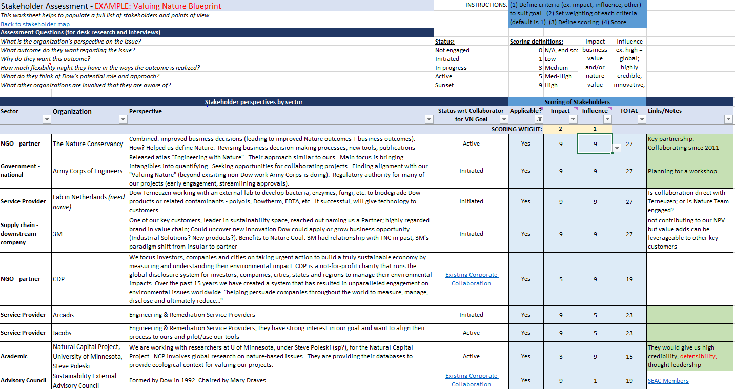
Sample Stakeholder Assessment: Valuing Nature

Slide 17
Six steps of
valuing nature
1. Set the vision
2. Build awareness
3. Embed tools
4. Collaborate externally
5. Track progress
6. Inspire & grow

Slide 18
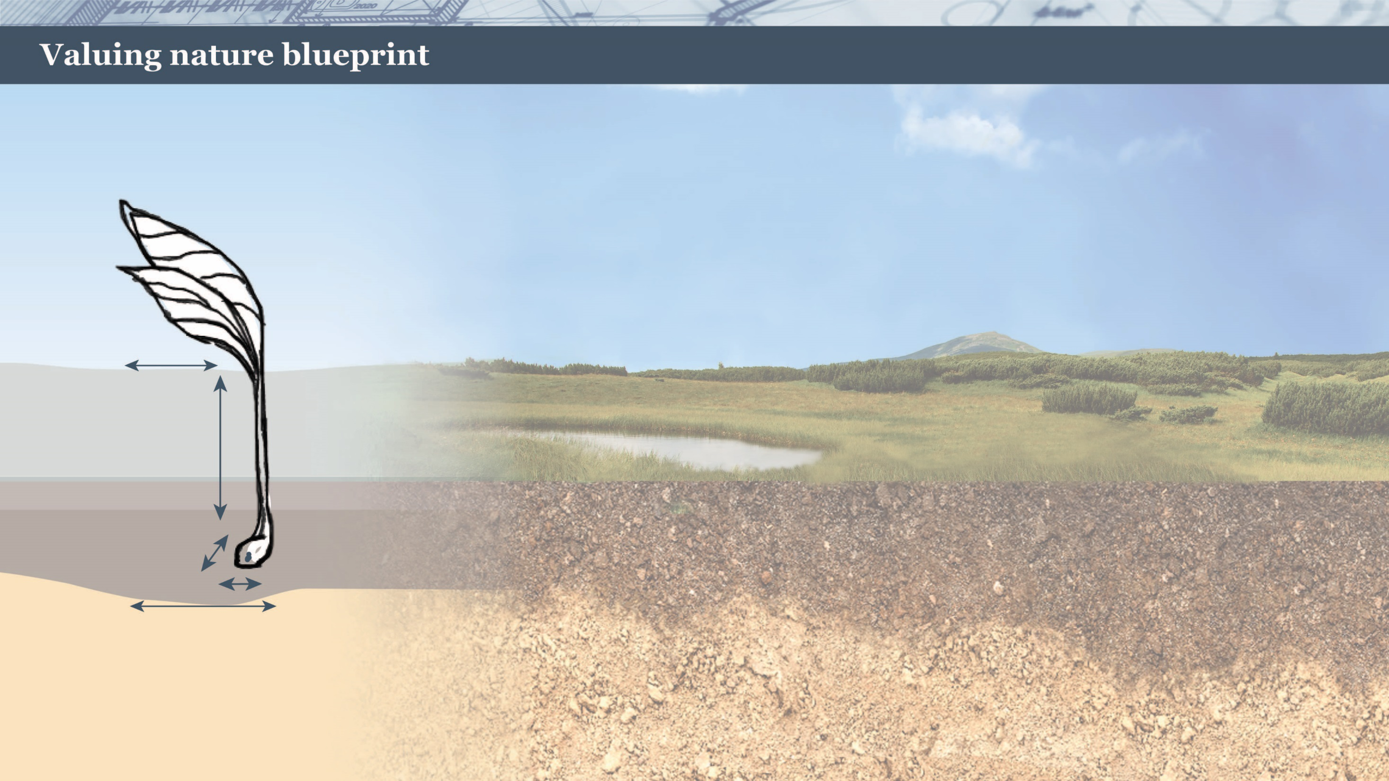
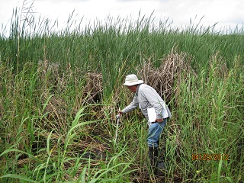
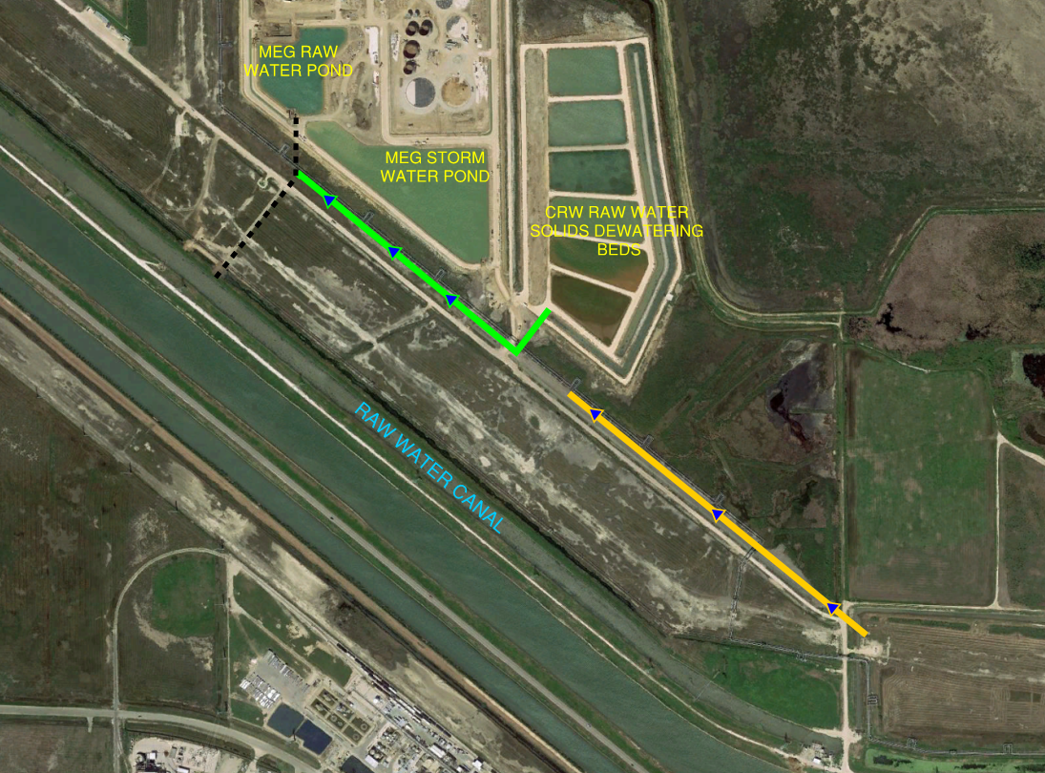
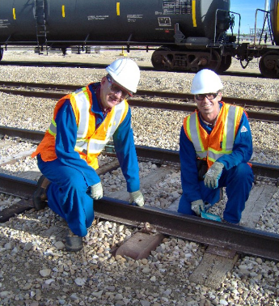
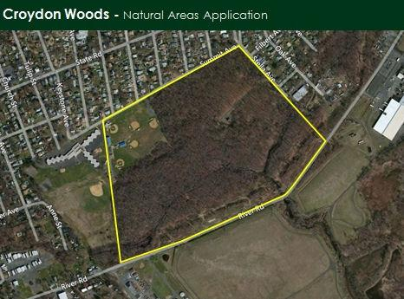
2
Build Awareness
- Case Studies
Engineered Natural Technology
Valuing Nature Can Be Your Technical Solution.
Dow’s Seadrift site needed to increase the level of water treatment to meet EPA effluent guidelines for suspended solids. Solution: Dow converted 110 acres of an existing treatment pond into a constructed wetlands for the purpose of natural treatment. The net present value savings exceeded $200 million and the area serves as great habitat for fish, alligators, raccoons, bobcats, deer, and birds.
Process Improvement
Valuing Nature Can Be Simple.
The Oyster Creek Water Recycle project contributed $694,000 in net present value. It was a simple piping change that diverts 600 gallons per minute of water from discharge to recycle. Not only did this result in an increase in water supply resiliency, but it reduced freshwater intensity and demand on the Brazos River basin (a win for Dow, a win for Nature)
Life Cycle Analysis
Valuing Nature Can Be Not Obviously Nature-related Initially.
Wood railroad ties soaked in creosote degrade over time and have to be disposed of at hazardous waste landfills. Steel railroad ties have a longer lifecycle, and that even though steel is carbon intensive, a Life Cycle Analysis identified it as a more sustainable solution. This project resulted in a $23 million net present value to Dow.
Land Monetization
Valuing Nature Can Be Property Sold Into Conservation.
Croydon Woods is 80 acres of coastal plain wetland forest adjacent to a Dow manufacturing facility. Dow sold the strategically important-for-preservation land to Heritage Conservancy. Business value included cash from the discounted sale and reduced long term maintenance costs. Meanwhile some of the last remaining wetland forest in the region is now preserved and ecosystem services benefits include recreation, stormwater storage, and air and water filtration. See published article.
Back to Blueprint

Slide 19
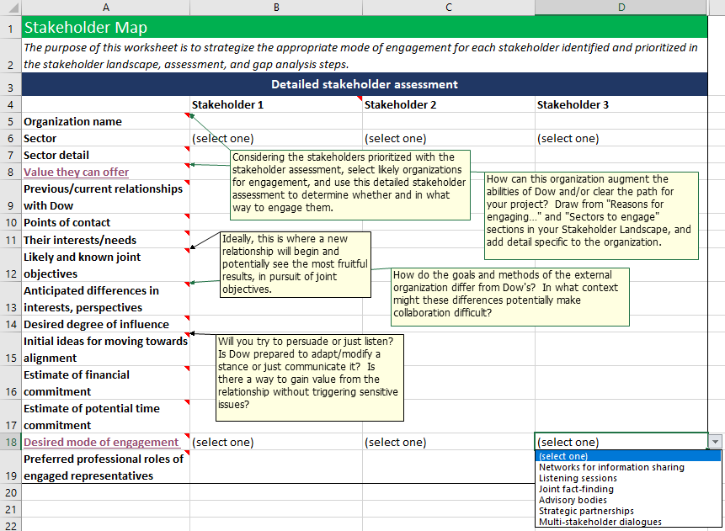
Stakeholder mapping – Stakeholder Map
Stakeholder map section
Detailed stakeholder assessment | Using all of the sources of value compiled in the previous sections, choose a few organizations to investigate in detail. Consider this a cost-benefit analysis of how much effort it may take for how much reward they may able to provide. Lastly, select a desired mode of engagement for each stakeholder, for which a reference has been provided.
Once you’ve identified the most likely stakeholders to engage with, can you research them to more fully understand their interests, needs, and values?
PROJECT
ALIGNMENT
Design and solidify a project strategy and assemble internal resources (people and existing materials)
STAKEHOLDER
MAPPING
Identify and prioritize external stakeholders for mutually beneficial engagement
EXTERNAL
ENGAGEMENT
Plan for working relationships and external communications with select organizations and audiences

Slide 20
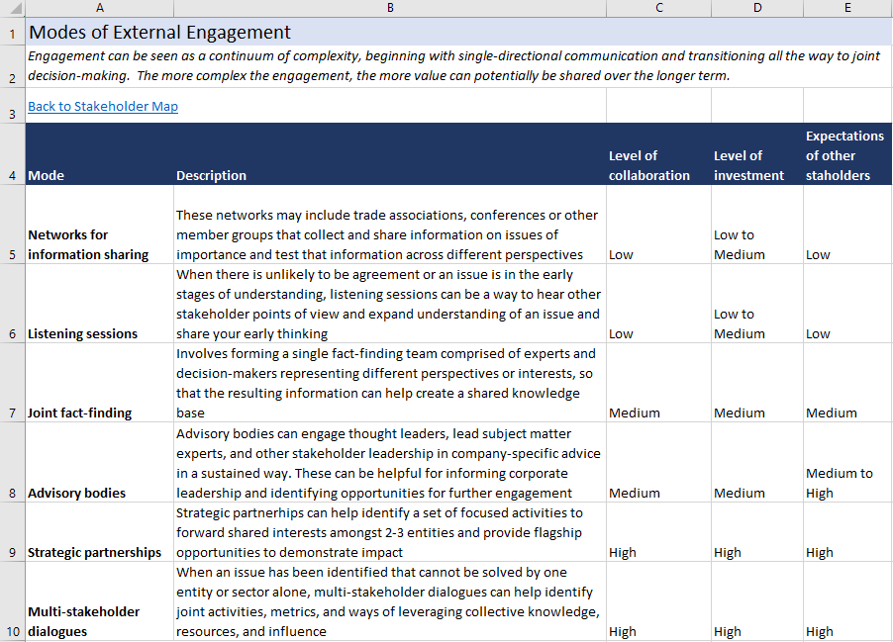
Modes of External Engagement
Consider how intensive you would like your engagement to be.
The more intensive the engagement, the more give-and-take it will require between Dow and external entities and the more investment will be required all around.
In addition to increased investment, the more intensive modes of engagement will require sharing ownership and authority over the project and its results with other entities.
In return for increased investment and shared ownership, any product that comes from a more intensive mode will likely have more buy-in and lower hurdles to implementation than those produced less collaboratively.

Slide 21
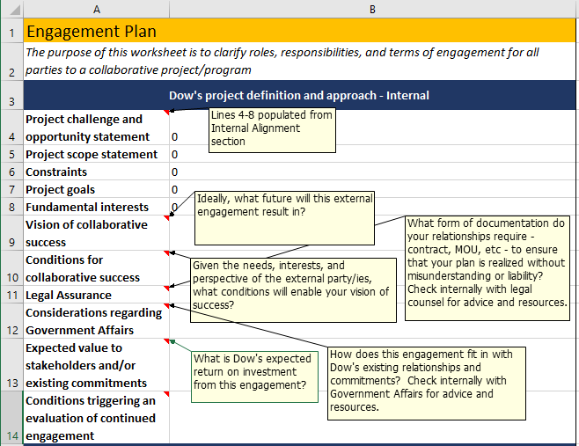
External Engagement – Engagement Plan
Engagement plan section
Dow’s project definition and approach – Internal | This section should be used if you are considering a partnership or collaborative working relationship with an external entity. The next section covers communications. A good first step of effective collaboration is to know thyself. The fields in this section should be used as a guided meditation of what really matters to Dow. The project goals, scope, and constraints have been brought forward again from the internal alignment section to ground your thinking.
Now that you’ve identified WHO you want to engage with, how do you plan for that engagement?
PROJECT
ALIGNMENT
Design and solidify a project strategy and assemble internal resources (people and existing materials)
STAKEHOLDER
MAPPING
Identify and prioritize external stakeholders for mutually beneficial engagement
EXTERNAL
ENGAGEMENT
Plan for working relationships and external communications with select organizations and audiences

Slide 22
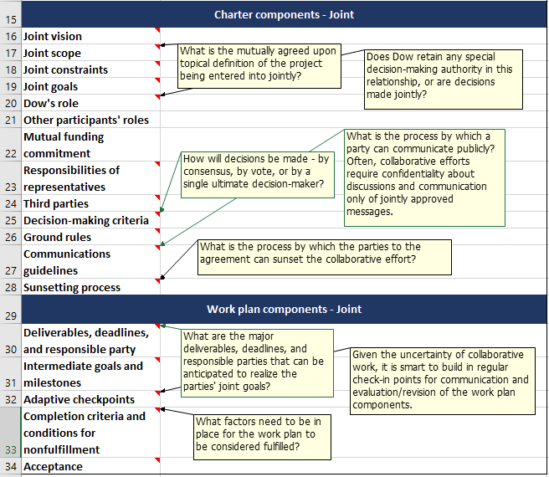
External Engagement – Engagement Plan
Engagement plan section
Charter components - Joint | A charter sets the “how” of an effective working relationship, including a joint focus, direction, and expectations.
Work plan components - Joint | A work plan sets the “what and by when” of a joint project, including deliverables, milestones, and what it will take to declare fulfillment. Recognizing that all projects, especially collaborative ones, will change with changing circumstances, it is especially helpful to schedule points in time when the direction and progress of the project can be re-evaluated and course corrected. They are referred to here as “adaptive checkpoints.”
PROJECT
ALIGNMENT
Design and solidify a project strategy and assemble internal resources (people and existing materials)
STAKEHOLDER
MAPPING
Identify and prioritize external stakeholders for mutually beneficial engagement
EXTERNAL
ENGAGEMENT
Plan for working relationships and external communications with select organizations and audiences

Slide 23
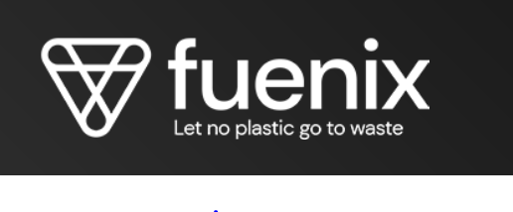
An Evaluation of the Toolkit’s Applicability on the Fuenix Collaboration in Plastics Recycling
Objective and background: Dow recently announced a partnership with Fuenix for the production of 100% circular plastic*. We asked the Project Manager, Carsten Larsen, to evaluate the Blueprint Thinking Toolkit retroactively to see if it would have been helpful in his team’s decision making process to choose Fuenix as a partner and the development of a corresponding engagement plan.
Blueprint learnings:
PROJECT ALIGNMENT
Design and solidify a project strategy and assemble internal resources (people and existing materials)
STAKEHOLDER MAPPING
Identify and prioritize external stakeholders for mutually beneficial engagement
EXTERNAL ENGAGEMENT
Plan for working relationships and external communications with select organizations and audiences
There was clear alignment and business value on the importance of finding a collaborative partner to increase feedstock recycling capability in our strategy to shift to a circular economy for plastics.
There was not much need for tools in this section for Carsten and his team.
Carsten and his team utilized existing tools to map out all of the possible partners and developed criteria to prioritize them.
They took the top 5-10 and researched the feasibility of engagement.
This led to Fuenix as the targeted collaboration partner.
They validated the importance of this step but did not need a tool to map out stakeholders and prioritize them.
Carsten had never initiated a partnership like this before and found that navigating the proposed working relationship and work plan process was new and challenging.
Having a tool to help think through many of the working relationship questions with a new collaborator would have been very helpful for him and the team.
External Engagement Lesson: Starting a brand new collaboration is challenging. Having a tool to help you think through all of the aspects of a working relationship and setting up an effective work plan can be helpful.
*https://corporate.dow.com/en-us/news/press-releases/dow-and-fuenix-enter-into-a-partnership-for-the-production-of-10.html

Slide 24
External Engagement – Inter-org Communications
Inter-org communications section
Project definition | The project goals and their connection to Dow’s strategy have been auto-populated here to serve as a foundation for evaluating Dow’s perspective on an issue.
Dow’s perspective | Know thyself applies here as much as it did with the engagement plan. These fields ask you to think about what portions of Dow’s perspective are founded on its fundamental interests and which may be flexible in response to new information or altered circumstances. Your degree of flex can be hard to predict, instead emerging organically as part of an ongoing external relationship. What is important here is checking your interests and entering into inter-organizational communications with an open mind.
What do you need to consider when communicating with your desired stakeholder?
PROJECT
ALIGNMENT
Design and solidify a project strategy and assemble internal resources (people and existing materials)
STAKEHOLDER
MAPPING
Identify and prioritize external stakeholders for mutually beneficial engagement
EXTERNAL
ENGAGEMENT
Plan for working relationships and external communications with select organizations and audiences

Slide 25
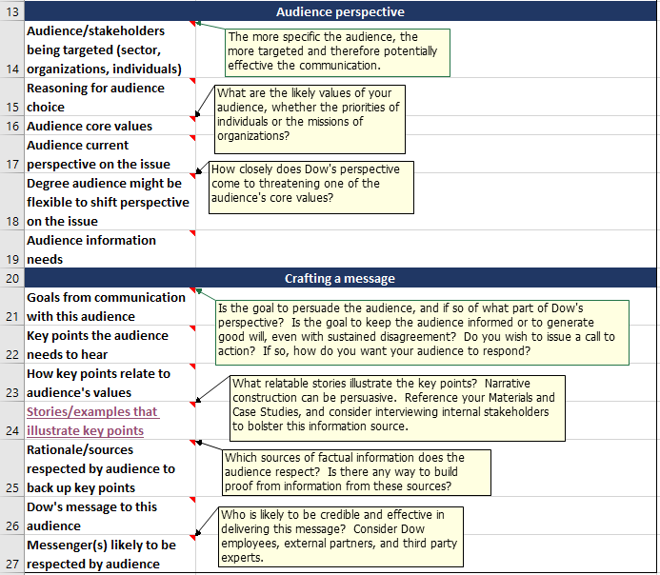
External Engagement – Inter-org Communications
Inter-org communications section
Audience perspective | With Dow’s own interests in mind, this next step draws on your research into your counterpart organization. Effective communication begins with the audience in mind and speaks to their core values and information needs.
Crafting a message | Persuasion is both difficult and incremental when an entity’s beliefs are founded on their core values. Be sure to set your expectations appropriately and embrace the goals of developing a shared understanding of an issue, even if minds don’t change as a result. Stories and trusted sources of information will go a long way to making your audience more receptive to any message you develop.
PROJECT
ALIGNMENT
Design and solidify a project strategy and assemble internal resources (people and existing materials)
STAKEHOLDER
MAPPING
Identify and prioritize external stakeholders for mutually beneficial engagement
EXTERNAL
ENGAGEMENT
Plan for working relationships and external communications with select organizations and audiences

Slide 26
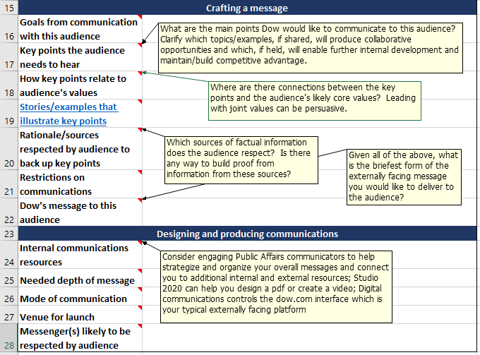
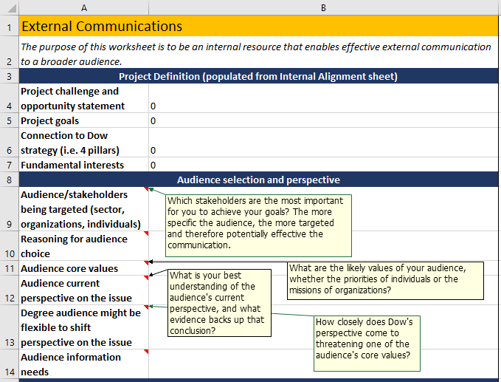
External Engagement – External Communications
External communications section
Project definition and audience selection and perspective | These sections are similar to those in the Inter-org communications section
Crafting a message | Double check that any external comms about a collaborative effort are responsive to the charter’s communications guidelines.
Designing and producing communications | Consider engaging Public Affairs, your communications experts for resources and recommendations.
How do you think about leveraging materials to be shared more broadly externally about your topic, i.e. create a “blueprint”?
The first part of
this section is
nearly identical
to the Inter-org
comms section.
PROJECT
ALIGNMENT
Design and solidify a project strategy and assemble internal resources (people and existing materials)
STAKEHOLDER
MAPPING
Identify and prioritize external stakeholders for mutually beneficial engagement
EXTERNAL
ENGAGEMENT
Plan for working relationships and external communications with select organizations and audiences

Slide 27
Product Safety Blueprint Learnings
Objective and background: Dow has been at the forefront of product safety for decades but how do we turn our expertise in this area into a value-add differentiation for Dow?
Team and progress: The Safe Materials for a Sustainable Planet (SMSP) 2025 Sustainability goal team owns the Product Safety blueprint and has worked on it in different iterations throughout 2019. The first iteration (1H19) was done with a Sustainability Academy team (NA Cohort 4) that provided fresh eyes on the topic and an initial framework of collaborative examples, gaps, and content materials. The current iteration is with the SMSP team to provide credible proofpoints for examples for blueprint materials for a broader audience, identify priority call to action areas, and corresponding strategic engagement plans.
Blueprint learnings:
PROJECT ALIGNMENT
Design and solidify a project strategy and assemble internal resources (people and existing materials)
STAKEHOLDER MAPPING
Identify and prioritize external stakeholders for mutually beneficial engagement
EXTERNAL ENGAGEMENT
Plan for working relationships and external communications with select organizations and audiences
1st iteration: Sustainability Academy Team 1H19
There were NO other companies found that shared a transparent, collaborative “blueprint” on product safety
Many collaborative examples were in the later stages of the product safety process and there may be an opportunity for collaboration earlier.
Worked with Studio 2020 to create interactive blueprint intended for broader consumer and customer population that can be tailored to specific collaboration opportunities in the future
2nd iteration: SMSP Team and Product Safety experts 2H19
Identified the need for each example/case study to have external proofpoints (like published articles) to be credible
Realized missed opportunities to document past collaborative efforts with NGOs
Very few pure play academic examples, most include additional industries or government collaborative efforts
Identifying specific topics we might want to have a call to action for engagement, specifically targeting NGO collaboration opportunities with clear deliverables
External Engagement Lesson: NGOs are a credible voice and active player in many of our most challenging issues. Plan engagement activities that have an externally publishable deliverable to be able to share the collaborative efforts done with NGOs.

Slide 28
Thank You and contact
Thank you for taking this course on the Blueprint Thinking Toolkit on External Engagement.
If you have any further questions, please contact:
Justine Nelson: jenelson@dow.com
Eunice Heath: ehheath@dow.com
Sarah Alexander: salexander@keystone.org
General: info@keystone.org

